Slide 1
WST Case Study: University for All Hybrid Symposium Daniel Elliott – Project Officer

Slide 2
University for All

Slide 3
What is Universal Design?
Universal Design is the design and composition of an environment so that it can be accessed, understood and used to the greatest extent possible by all people regardless of their age, size, ability or disability.
Not a set of rules but a set of suggestions that can be mixed and matched according to specific goals and can be applied to particular contexts.
Universal Design is flexible, it facilitates choice and encourages reflective, forward-thinking practice.

Slide 4
What is Universal Design for Learning?

Slide 5
Event Schedule
9.30: Welcome
9.35: Opening Address: Professor Mark Rogers, UCD Acting President
9.45: Keynote address: Dr Thomas J Tobin, University of Wisconsin-Madison
11.00-11:30 Break
11:30-1:30 Faculty Partner Presentations
13:30 Launch: Who Counts? University for All Data, Metrics, and Evidence 2020-2021,
13:40 Concluding remarks
Lunch: UCD Student Village

Slide 6
Purpose of the Event
What did we want to achieve?
Showcase the work of the Faculty Partnership Programme
Host an international renowned expert
Convince the wider institution of the benefits of UDL
Audience: internal colleagues, colleagues from other HEIs and FET sector, policy makers and international professionals.
Notes:
Clarity needed in order to plan effectively

Slide 7
Key Facts
90 in-person attendees, 70 online tuning in from 8 different countries
13 different Irish HEIs
Over 250 people registered over Eventbrite
21 speakers
Technical support specialists: AVCOM

Slide 8
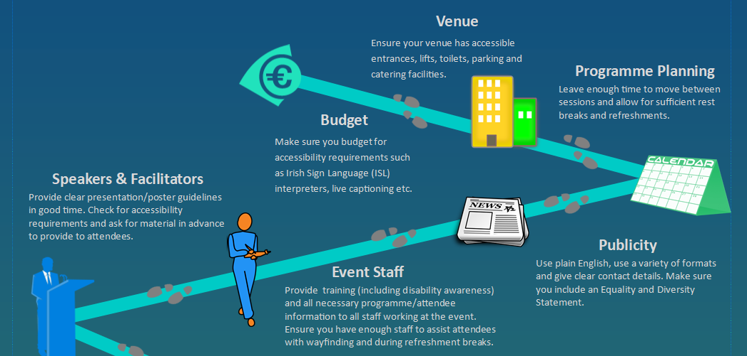
Events
Universal Design of Events

Slide 10
Key Considerations - Keynote
Keynote which was interactive – Dr Thomas Tobin.
Numerous meetings to prepare for this session – giving him the context and ensuring he understood the brief.
Listened to both audiences (online and in-person). Reframing the questions and incorporating the answers into the presentation.
Allowed time for reflection and discussion.
Making the online audience feel they were part of the discussions.

Slide 11
Key Considerations – Lightning Presentations
Faculty Partners delivered lightning style presentations.
Well briefed, worked closely with them on the communication and purpose of this event.
3–4-minute presentations with key takeaways from each (timed).
Use of videos and other visual prompts which audience responded well to.
Different disciplines and contexts allowed for fresh perspectives, pace and styles.

Slide 12
Key Considerations – Technical Support
Symposium hosted as a Zoom webinar.
Recording and livestreaming by AVCOM - again series of meetings and calls to achieve exactly what we wanted.
4 tech specialists on the day
2 staff assigned to manage webinar and online participants (not speakers).
Having large enough space to accommodate all tech equipment necessary.
One staff member taking care of social media (online engagement)
Sharing of high quality recordings (video editing)

Slide 13
Attendee Feedback

Slide 14
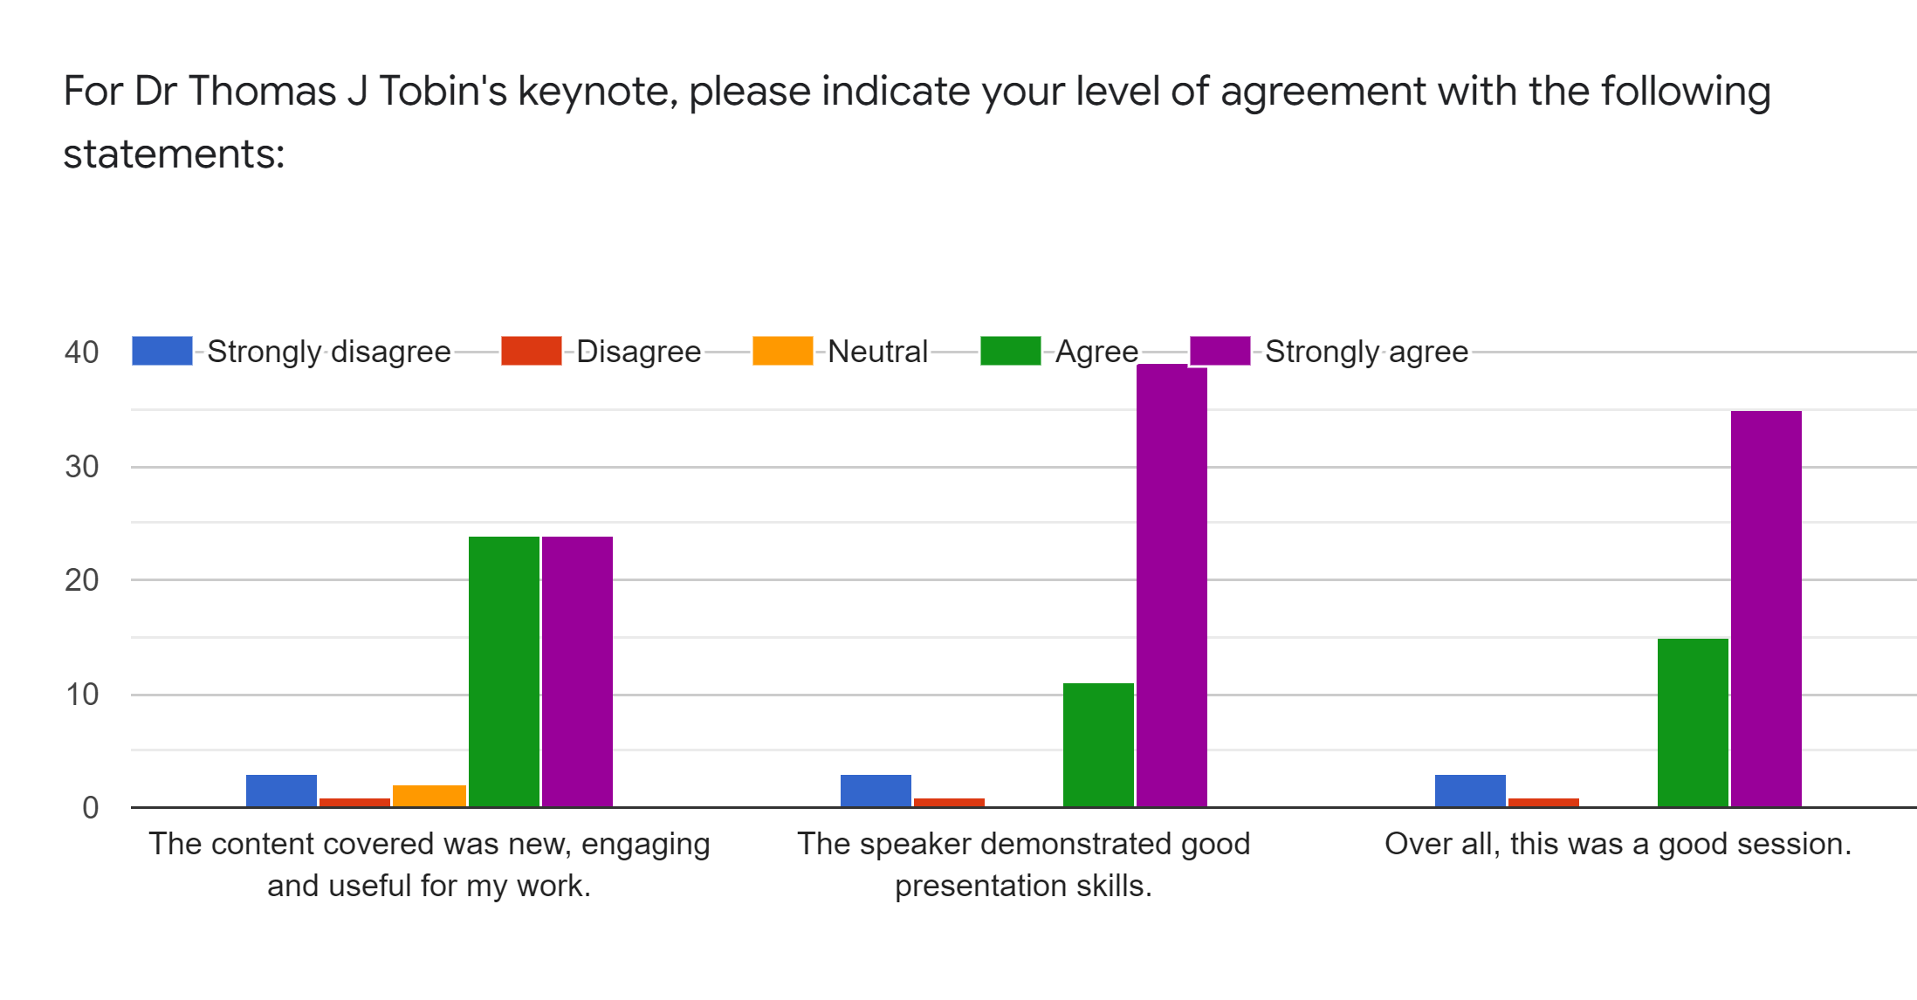
Attendee Feedback

Slide 15
Attendee Feedback
I would love you to continue making it accessible over Zoom. I joined from Australia and absolutely loved seeing the university-wide approach to UDL.
I feel trying to do the online/people in the room sometimes means it gets a bit weird. Also, I think for a keynote, we come for a solid session, not one with lots of Q&A.
Highly engaging and modelled the principles of UDL. Managed the in person and online audience brilliantly so that everyone was included and participated.

Slide 16
Enhancements
Including the student voice and the impact on learners.
Use of other online tools to engage online audience further – Padlet, Mentimeter, polls, etc.
Breakout sessions for online networking at break.
Incorporate more videos into the programme.
Do a short prep session with Faculty Partners to ensure they know how to use the tech and are not nervous.

Slide 17
Key Takeaways
Close collaboration with tech experts as well as speakers.
Outlining purpose from the start – planning well in advance.
Varying and engaging content that appeals to as wide an audience as possible.
Use of Universal Design key to event planning process.

Slide 18
Resources
Event Checklist
Symposium Recordings
University for All Resource Hub
Digital Badge for Universal Design
Intro Badge and SSE Badge

