Slide 1




COMPHACRISIS The Story of a Grant
180%
|
0°
279 x 279
Dr Mina Hosseini
Marie Skłodowska-Curie Postdoctoral fellow
UCD Sutherland School of Law
This project has received funding from the European Union’s Horizon Europe MSCA programme under grant agreement No. 101061575

Slide 2
Who Am I? Mina Hosseini
Marie Skłodowska-Curie Postdoctoral fellow 2022-2024
Assistant Professor, USC, Tehran, Iran 2018-2022
PhD in Competition Law, SBU, Tehran, Iran 2017
Attorney at Law, Iranian Central Bar, 2010
LLM, Economic Law, SBU, Tehran, Iran, 2009
LLB, Law, Shiraz University, Shiraz, Iran, 2006

Slide 3

What I do?
COMPHACRISIS: The enforcement of EU Competition Law in the pharmaceutical sector: before, during, and after a health crisis: (Learning from the COVID-19 pandemic)
Horizon Europe MSCA PF, UCD Sutherland School of Law (2022-2024) , Project Supervisor: Professor Imelda Maher

Slide 4
Marie Skłodowska-Curie Postdoctoral fellowship
Highly competitive program funded by the European Union
Open to researchers of all nationalities and fields of study with a PhD.
(European and global Fellowships)
Opportunities to network with researchers and professionals
Opportunities for researchers to gain international experience and develop new skills
Promoting public engagement and outreach activities
Mobility, career development and Knowledge transfer

Slide 5





Developing an Idea
DEVELOPING A CLEAR AND COMPELLING RESEARCH IDEA
IDENTIFY CRITICAL, INNOVATIVE, FEASIBLE RESEARCH QUESTIONS OR HYPOTHESES
IDEA SHOULD BE GROUNDED IN EXISTING LITERATURE, ADDRESS A GAP IN KNOWLEDGE, AND HAVE THE POTENTIAL FOR SIGNIFICANT IMPACT.
BRAINSTORMING WITH COLLEAGUES, ATTENDING CONFERENCES, AND FOLLOWING NEW TRENDS
CONSIDER THE EU'S PRIORITIES AND ENSURE ALIGNMENT WITH THE UN SUSTAINABLE DEVELOPMENT GOALS

Slide 6

Excellence
Can you make your topic more engaging? What is the significance of your research? Who will benefit from your work? Have you clearly defined your research questions? Does your methodology bring new ideas?
Is your proposal ambitious enough?
Are your Open Science practices justified? Have you defined your FAIR principles? Will your project involve knowledge transfer? Have you adequately addressed gender aspects in your project? Are interdisciplinary aspects integrated into your research?

Slide 7
Multidisciplinary Aspects
IP law and Policy
Sector regulations
Public Health
Human Rights
Public Policy
COMPHACRISIS
Competition Law
Social Insurance Policy
Consumer Protection
Patient’s Rights
Economics

Slide 8





Implementation
Have you clearly defined your work plans and work packages?
Have you included all the necessary information in the Gantt chart?
Have you clearly defined the quality and capacity of the host institution?
Are the efforts assigned to the work packages realistic and appropriate?

Slide 9

Impact
Does the fellowship provide a practical and academic opportunity for the researcher?
Will the fellowship enhance the researcher's career prospects?
Will your project's results significantly impact policymakers and make a notable contribution to academia?
Is the discussion of expected societal impact and international engagement detailed enough?
Have you identified the primary message, tools, and channels to reach the target audience?
What strategies will you use to promote your project and its outcomes beyond the project's community?

Slide 10
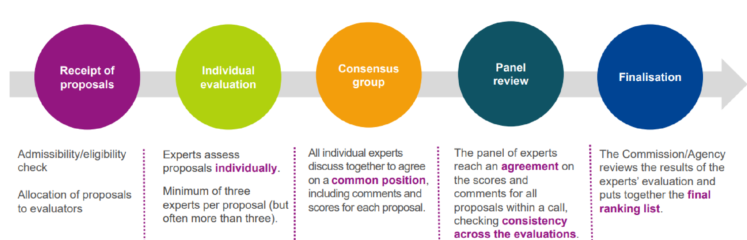
Evaluation
• Write your proposal in clear and simple language that individuals outside your field of expertise can understand.
• Include the researcher's CV, highlighting relevant experience and transferable skills.
• In the event of proposal rejection, carefully apply the reviewers' comments and revise the proposal accordingly to address any identified weaknesses or areas for improvement.

Slide 11

Common Pitfalls
Not considering Career development
Lack of clarity in Gantt charts and work plan
Lack of originality and innovation
Not simplifying enough
Not having a big picture about the project’s goal
Failure to address the evaluation criteria
Not justifying the synergy between researcher, supervisor and host
Not considering open Science
Not having a clear risk management strategy

Slide 12



Conclusion
CAREFUL PLANNING, ATTENTION TO DETAILS,
A CLEAR AND COMPELLING RESEARCH IDEA
CONSIDERING THE CAREER DEVELOPMENT PLAN
DEFINING THE TRAINING AND DISSEMINATION ACTIVITIES UNDERTAKEN THROUGHOUT THE PROJECT.
FOLLOWING THE BEST PRACTICES
AVOIDING COMMON PITFALLS
SEEKING FEEDBACK FROM COLLEAGUES AND MENTORS

Slide 13

1-MSCA Work Programme 2-MSCA PF Guide for Applications 3-MSCA Guidelines on Supervision 4-MSCA Evaluation Form 5-MSCA Green Charter
Further Reading

