Slide 1
Creating the Academic Integrity Course
Peter Hickey, UCD Library

Slide 4
Student Plagiarism Policy icy
5.1.2 UCD Library provides education about, and promotes University policy on, academic integrity and has a repository of resources on plagiarism and how to avoid it
5.1.3 Schools (and non-School teaching units) arrange for students to receive advice and guidance on correct citation and referencing, on avoiding plagiarism, and on the potential consequences of plagiarism.
5.2.1 Head of Schools’ responsibilities include: ....... d) Ensuring that appropriate and timely student advisory arrangements are in place to promote academic integrity in the subject area(s) and to educate students about avoiding plagiarism;
5.2.3 Module Coordinators’ responsibilities include: a) Ensuring that their students are briefed on avoiding plagiarism and providing them with information about expectations for citation methods for all assessed work in their module, prior to the students submitting assessments or taking examinations;

Slide 5
Report of the UCD Library Referencing Review Group
2020
Diarmuid Stokes
30% of students
Received no training in citation
and referencing
90% wanted more training
23% of academic staff
Did not provide any training in citing & Referencing
Academics
16.4%
473 respondents
- 184 staff
- 289 students.
Students
82.1%
Good understanding of Referencing & Citing
Notes:
66% Sy students approach them for help
Anxiety learning diff styles A& H 6 styles

Slide 6
Steering Committee
Prof. Anne Drummond, Co Lead, School of Public Health, Physiotherapy & Sports Science
Dr. Audrey McNamara, Project Manager
Brian Treacy, Carla Gummerson, Aoife Bracken, UCD Students Union
Prof. Naomi McAreavey, Vice Principal T&L, College of Arts & Humanities
Prof Niamh Cherry Moore, Vice Principal T&L, College of Social Science & Law
Prof James Sullivan, Vice Principal T&L, College of Science
Prof. Sue Rackard, Vice Principal T&L, College of Health & Agricultural Sciences
Dr. Megan McGuirk, College of Business
Dr. Zeljka Doljanin, Manager, UCD Writing Centre
Niall Watts, Catherine Murphy, UCD IT Services
Jenny Collery, James Molloy, Vanessa Buckley, College Liaison Librarians

Slide 7
Every student has access to timely, consistent and uniform information and guidance before they submit their first assignment
Academics have confidence that baseline training is available to all students
Evidence of completion
Open access resource
Prevent
Accidental plagiarism (better Education)
Deliberate Plagiarism (Better awareness)
Received 48,000 funding

Slide 8
Pilot
Module | Class size | No. Completing | Feedback received
English | 389 | 207 | 137
History | 236 | 80 | 26
Nursing x 2 | 59 | 52 | 11
Access & Lifelong Learning module x 2 | 52 | 52 | 35
Total | 736 | 391 | 209

Slide 9
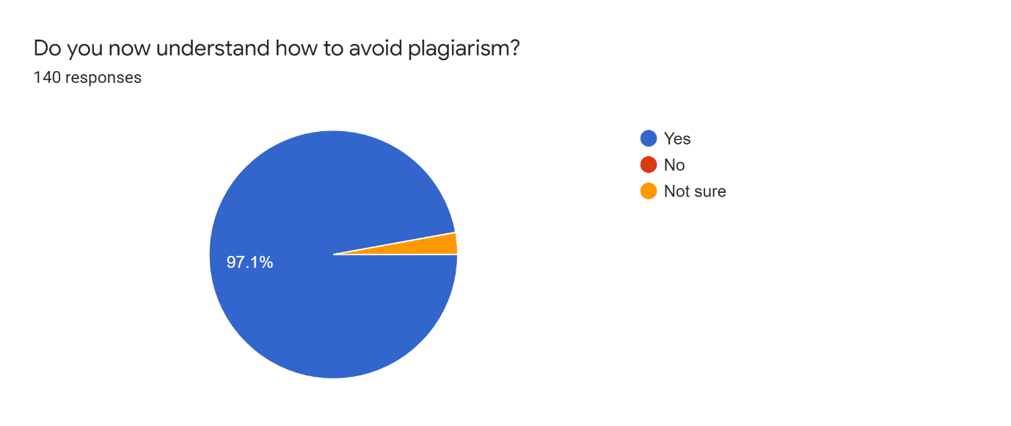
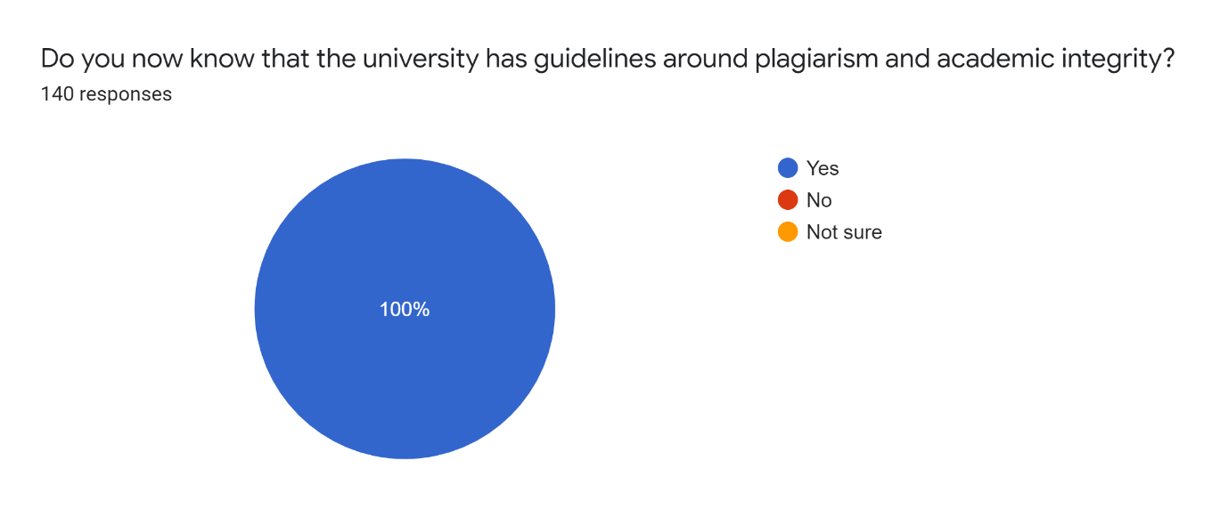
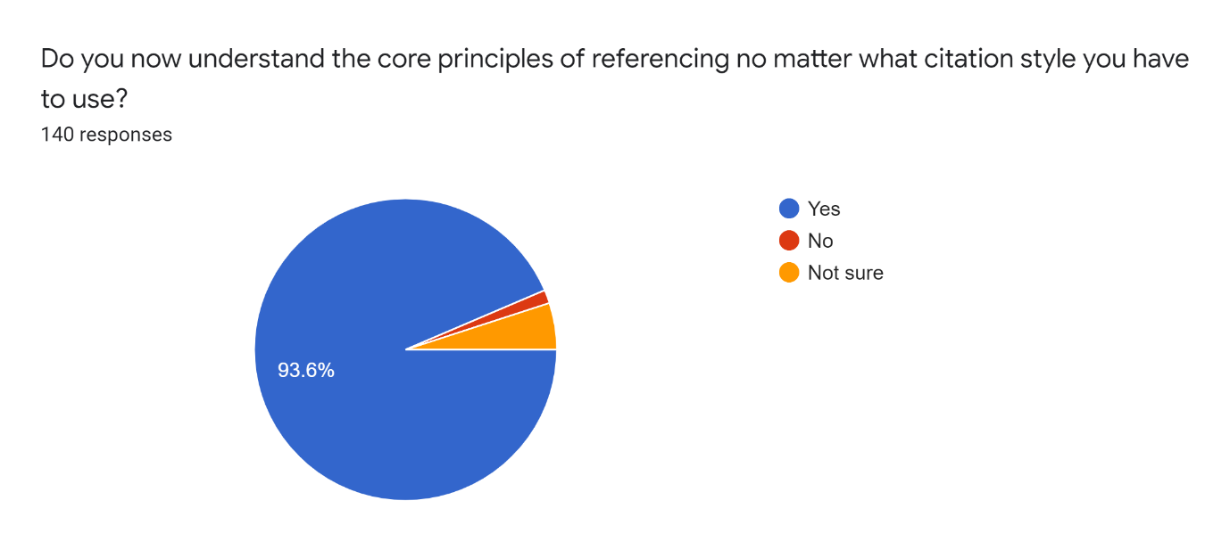
Pilot Feedback

Slide 10
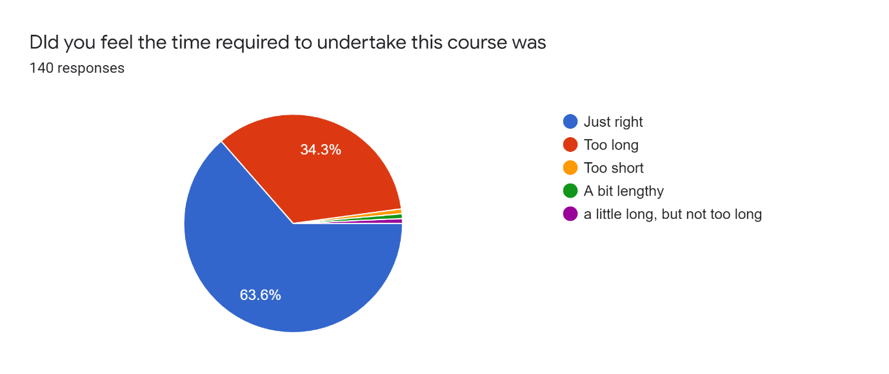
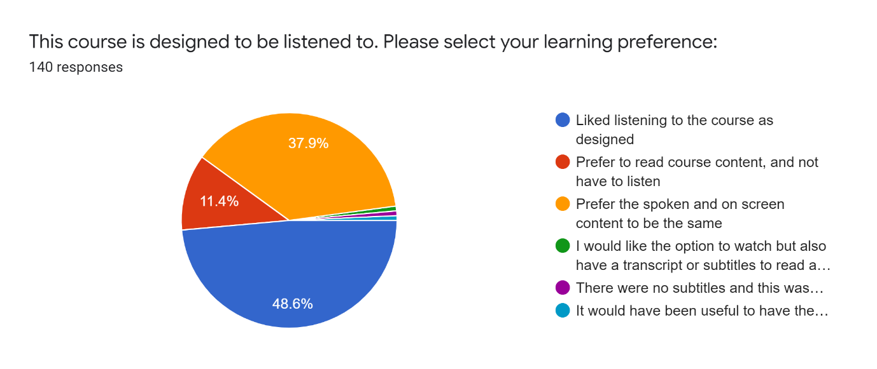
Pilot Feedback

Slide 14
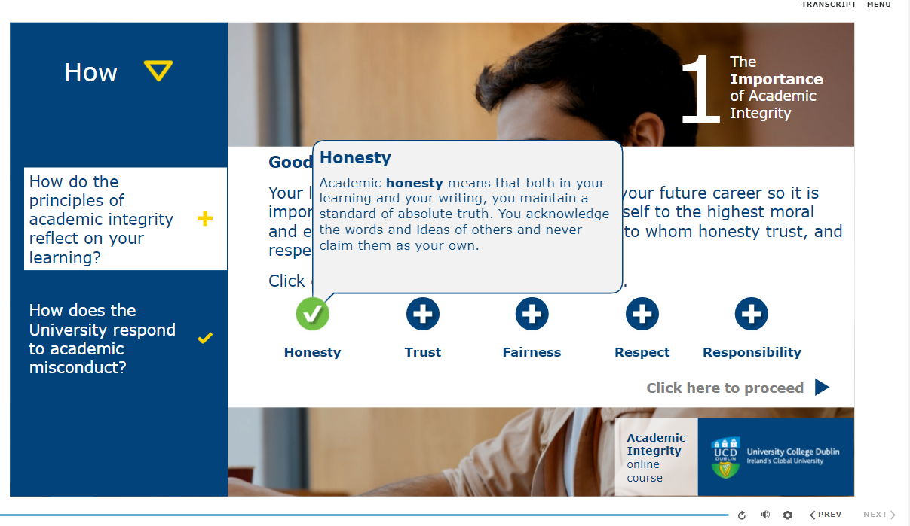

Slide 17
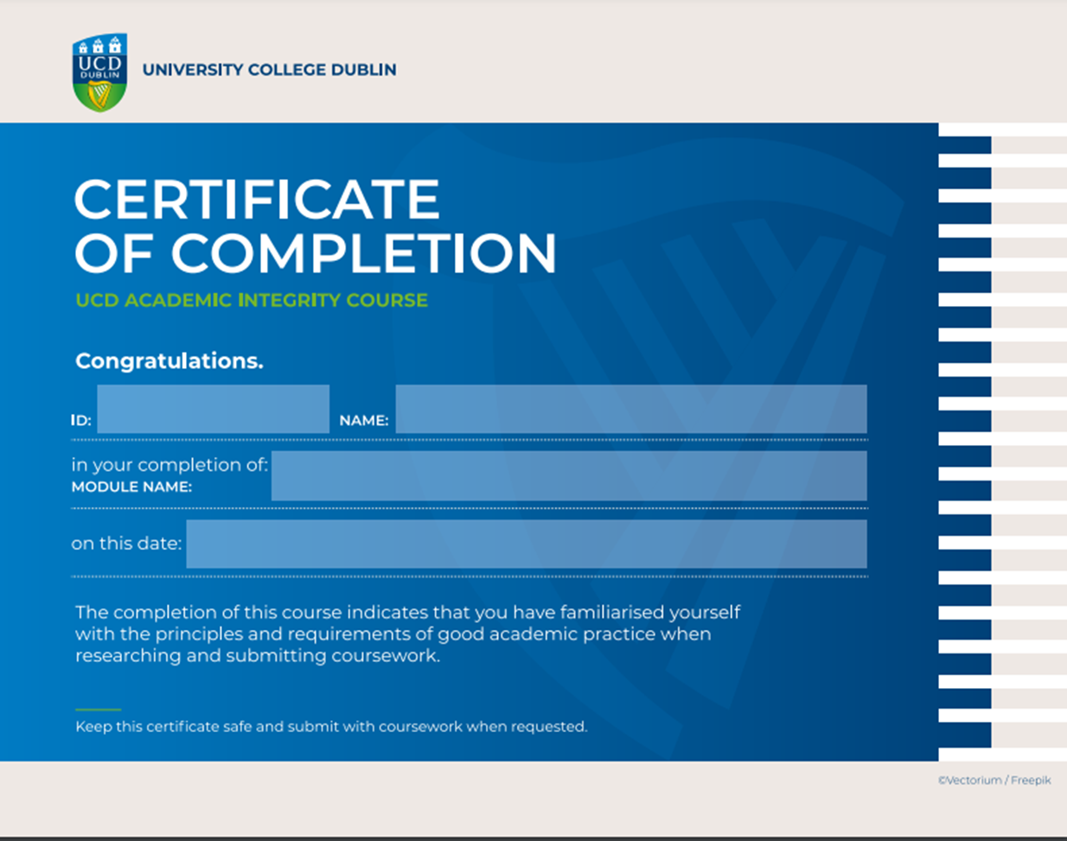
Quiz
10 questions
Random selection
80% to pass
Only have to repeat the incorrect question, not whole quiz
Quiz released on completion of the full course
Cert can be provided as evidence on other programmes
Quiz: Jenny Collery, Niall Watts, Catherine Murphy
Certificate Design: Catherine Bodey

Slide 18
Useful Information
Brightspace Explore module
Guidelines available for Academics and Students
Course takes 45-60 minutes to complete. All sections must be completed
Quiz takes 10 minutes
Not credit bearing
Not mandatory

Slide 19
Course completions and certificates awarded
February – December 2022 3428
January – March 2023 329
In progress 463
Total Registered 4220

Slide 20
Any questions, you can contact me
Peter.hickey@ucd.ie

