Slide 1

Developing global collaborations for an environmental humanities project: The Humanities Institute’s GHI grant
Co-I and Project Manager: Dr Megan Kuster (megan.kuster@ucd.ie)
Co-Is: Prof Anne Fuchs and Dr Sarah Comyn
Work Smarter Together
23 March 2023

Slide 2
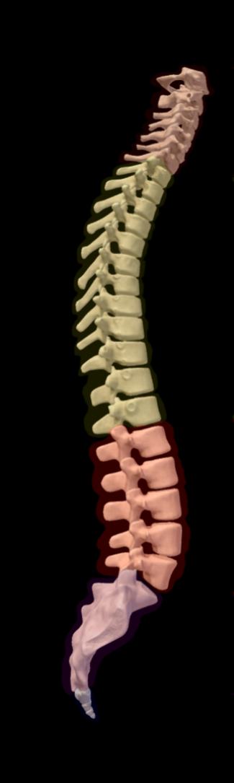
The backbone of the Humanities Institute-led, Mellon-funded, Global Humanities Institute (2023) project is collaborative partnerships – at all levels: institutional, national and international.

Slide 3
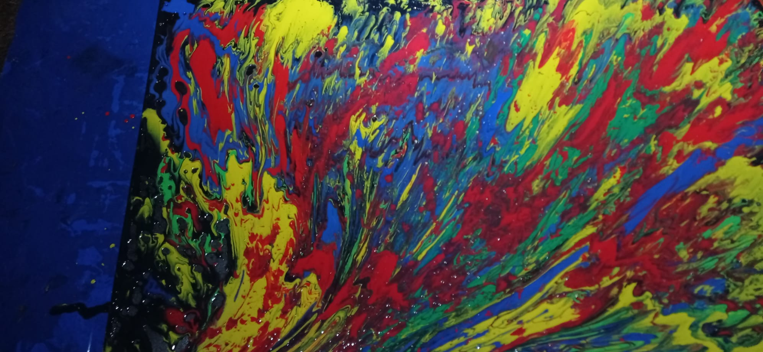
Early-Stage Grant Proposal Development

Slide 4
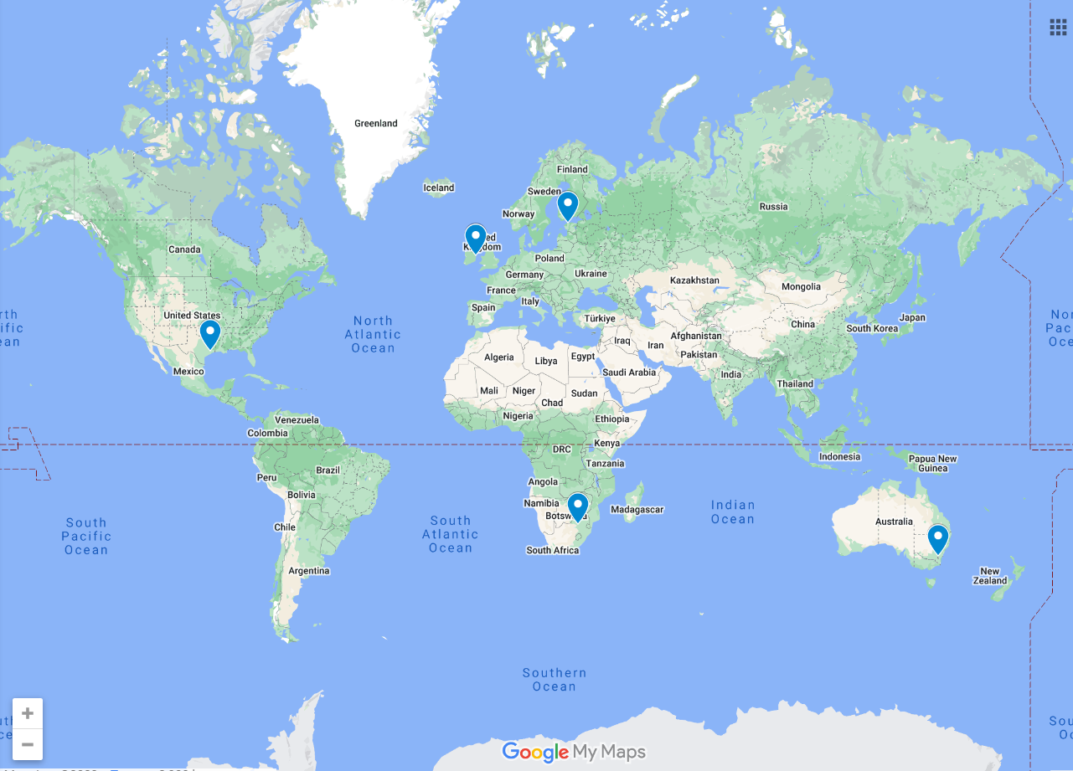





Slide 5
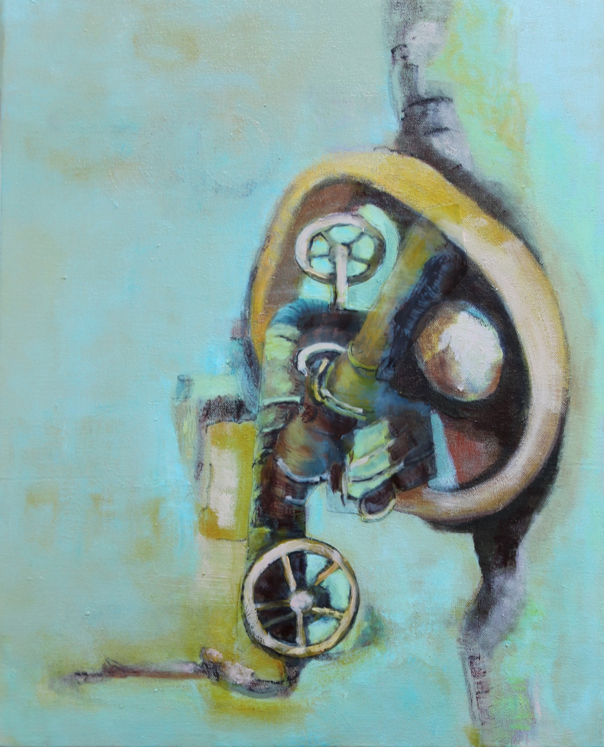
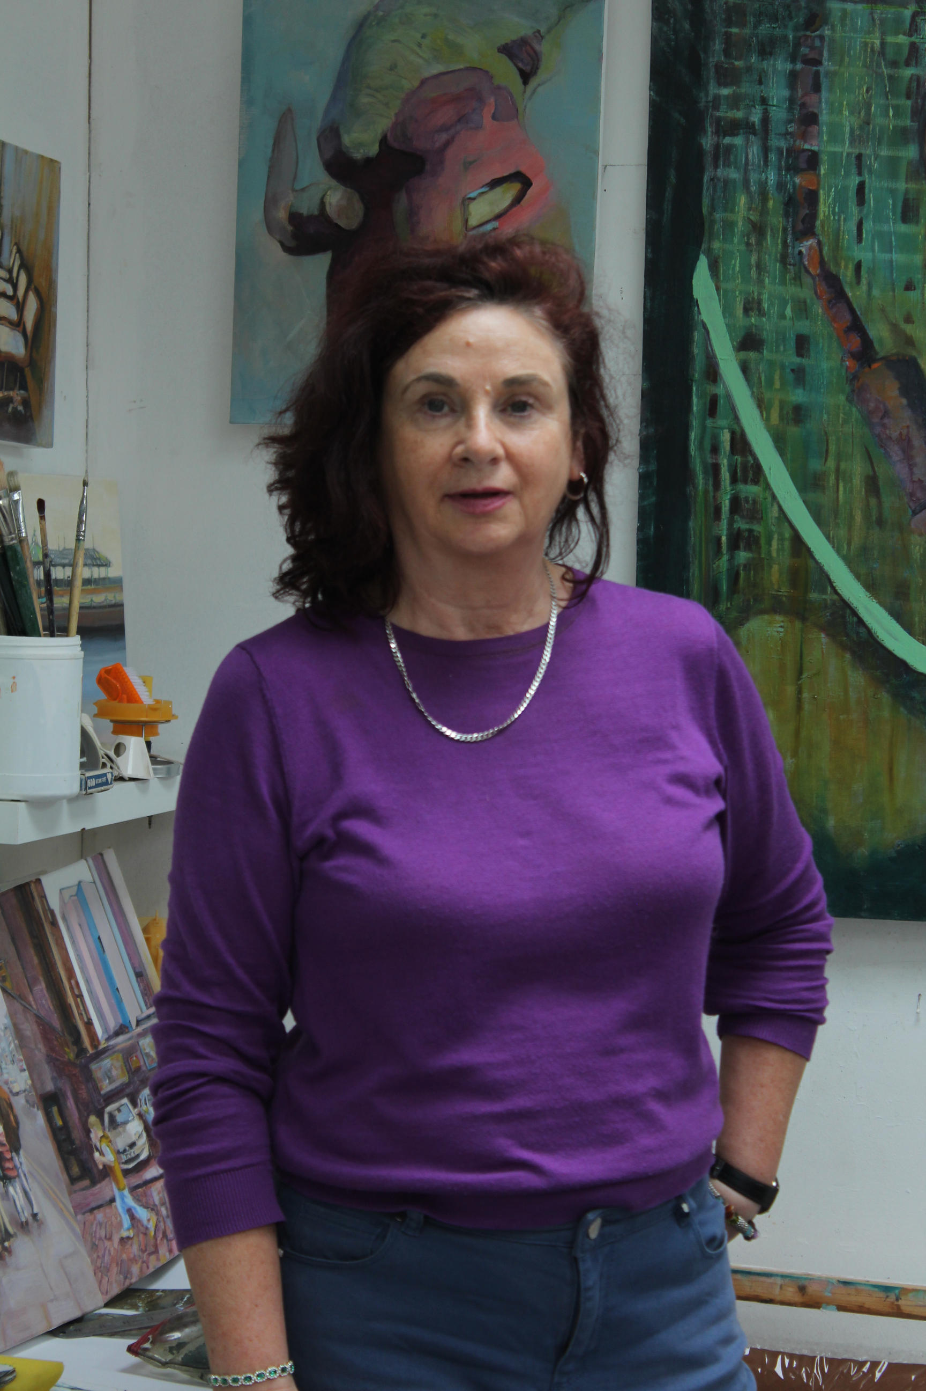
Developing the full proposal: Bolstering partnerships
"Over Turn". oil and mixed media on canvas_50 x 40 cm_2021_Judy Carroll Deeley
Website: https://www.judycarrolldeeley.com
Instagram: judy.carroll.deeley

Slide 6
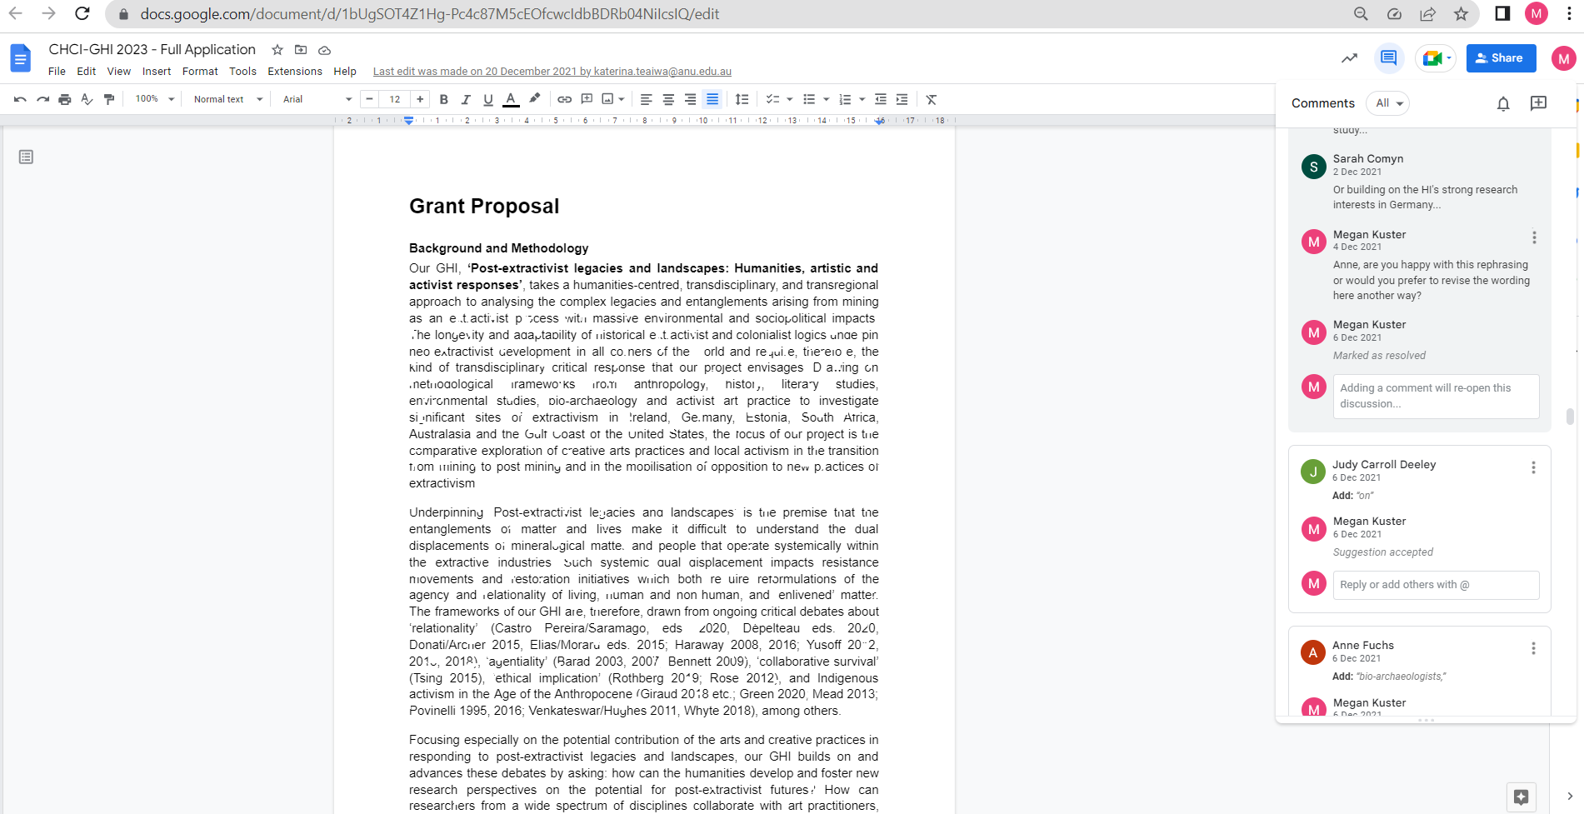
Developing the full proposal: Collaborative writing

Slide 7
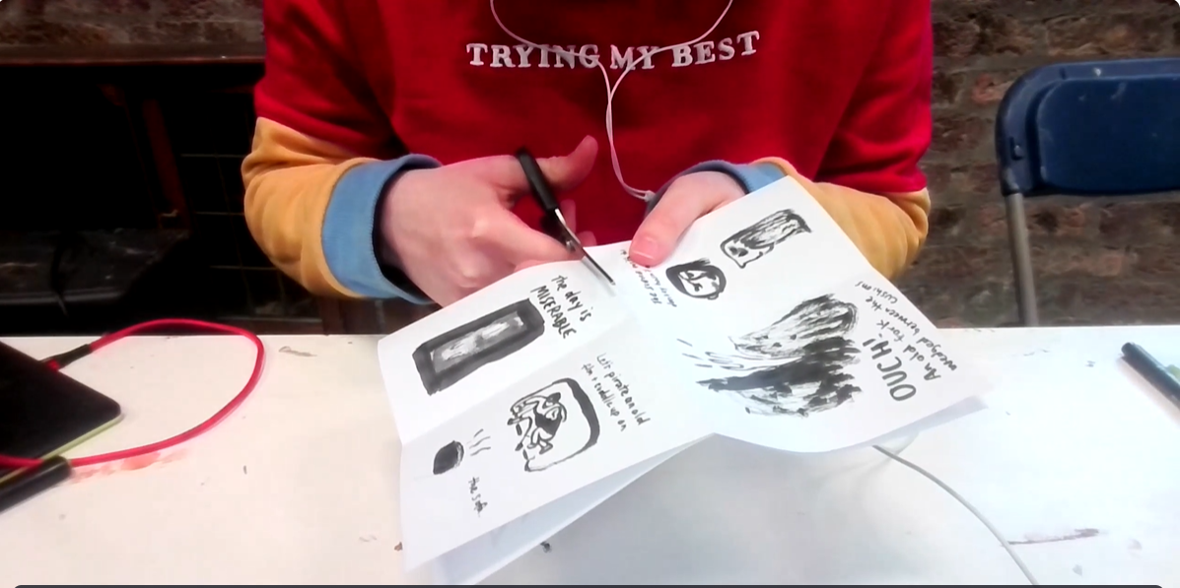

Grant delivery and continuing collaborations: International student art competition

Slide 8
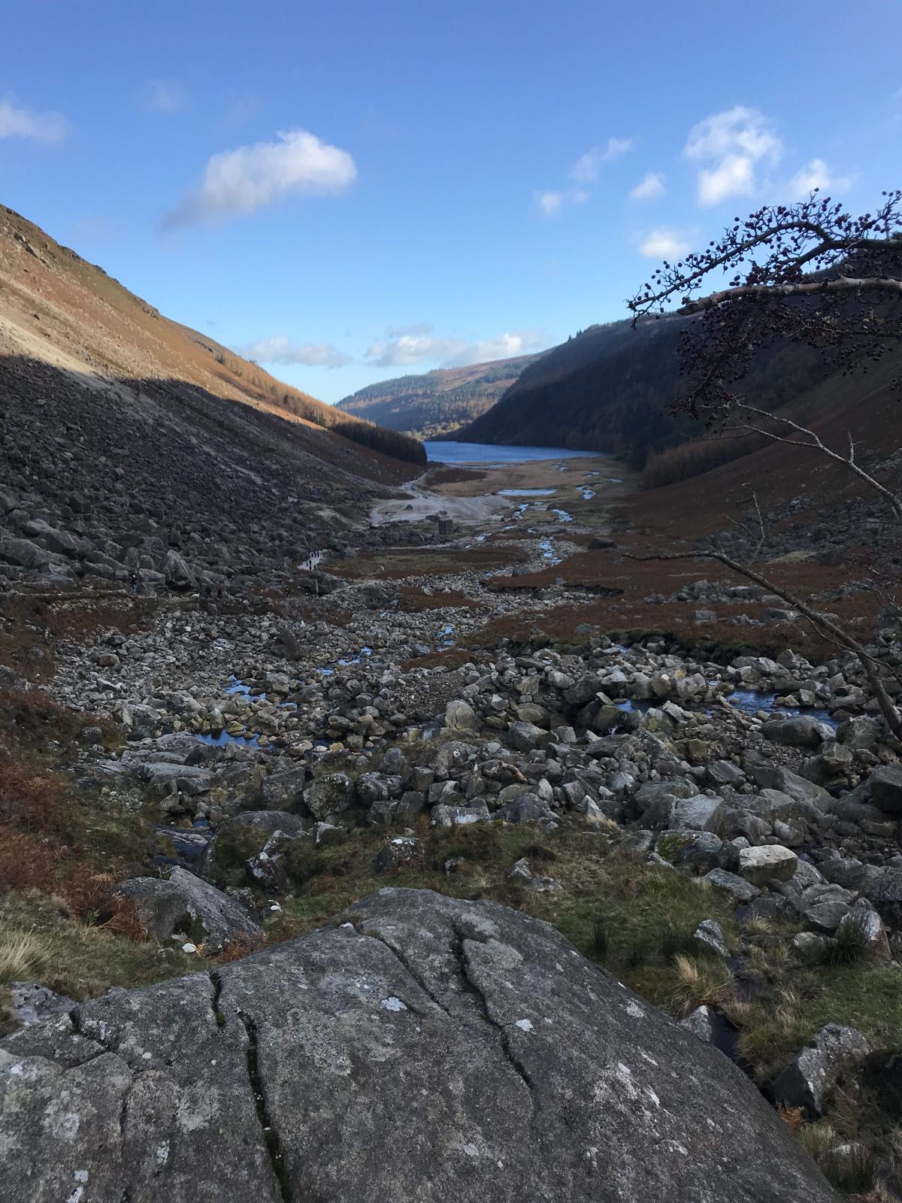
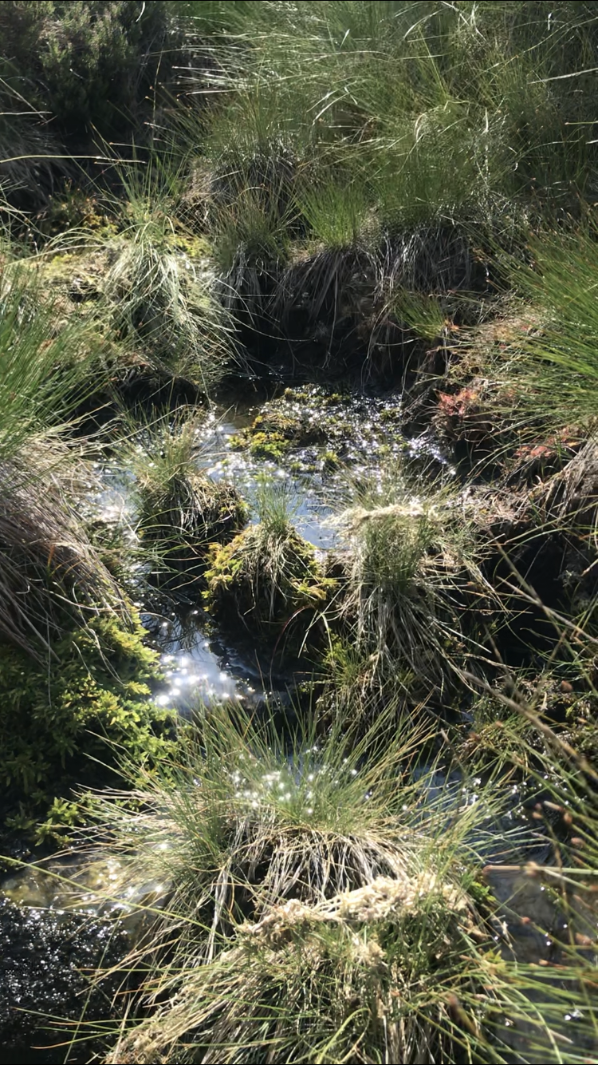
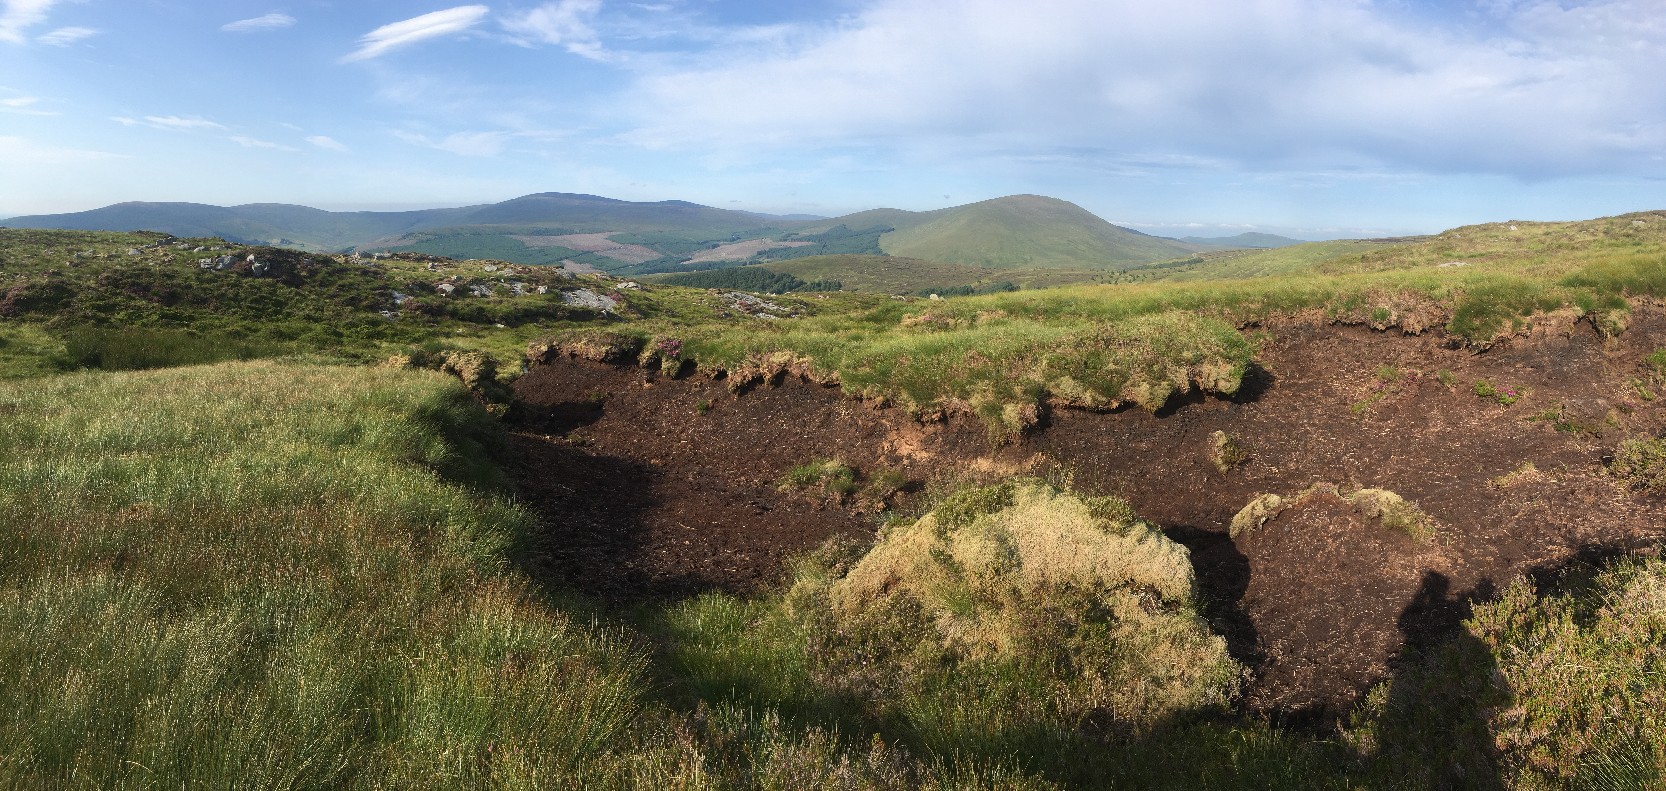
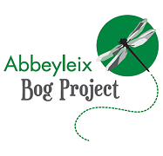

Grant delivery and continuing collaborations: UCD Symposium, 4-8 July 2023

Slide 9
Thank you!
megan.kuster@ucd.ie
https://extractivistlegacies.org/

