Slide 1
Dignity and Respect Initiative
Work Smarter Together Conference 2023
Rory Carey and Marcellina Fogarty

Slide 2
Dignity and Respect Review & Implementation
New Policies and Report published following review:
- Research into good practice elsewhere
- National developments e.g. IUA Guidance for Universities on responding to alleged Sexual Misconduct, ESHTE Report
- Large scale internal and external consultation
Implementation – 6 Workstreams
D&R Oversight Group
3 Tiers of Training
Comms Campaign
External
Monitoring and Reporting
D&R Support Service
Cultural Transformation

Slide 3
3 Full-Time Support Advisers
Support to Employees and Students
Satellite Clinics in the Student Village and Blackrock Campus
Outreach across the UCD (including areas such as clinical sites and Lyons farm)
Arranging seminars

Slide 4
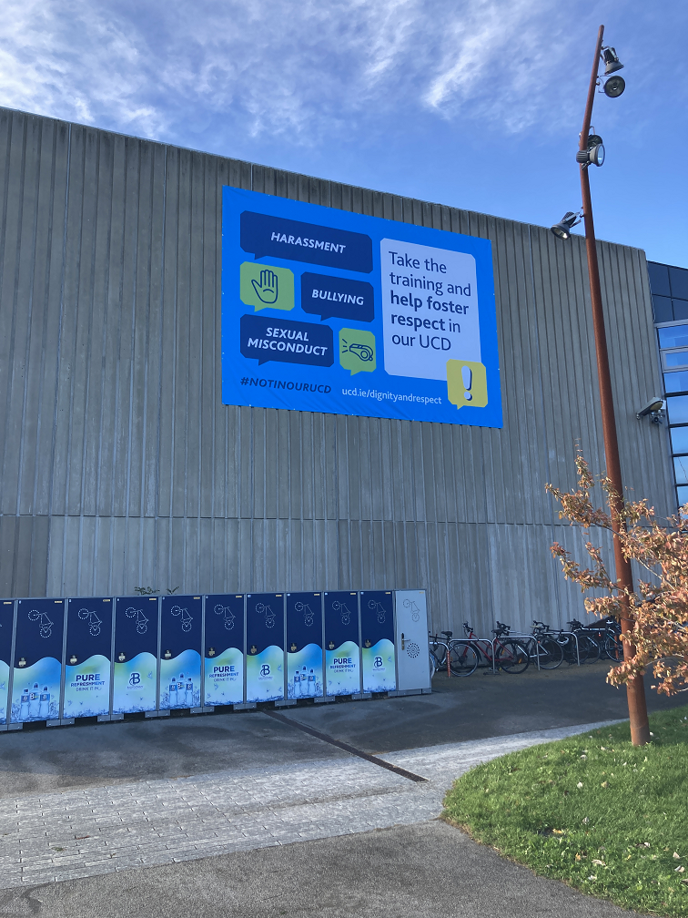
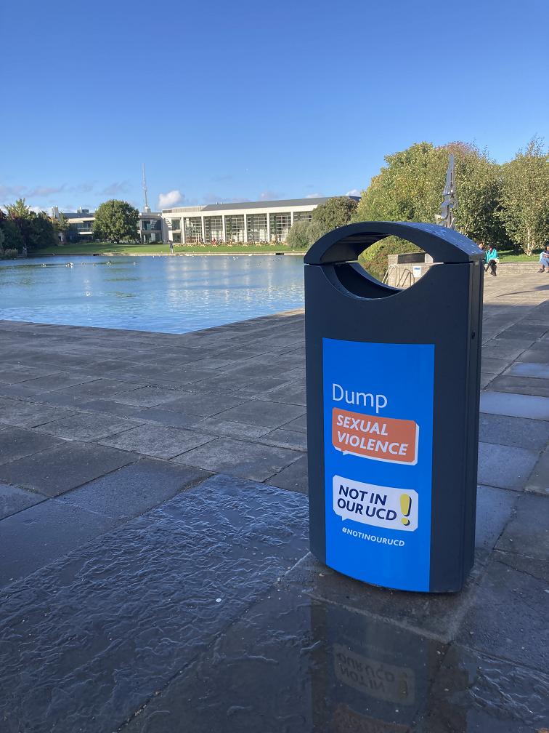
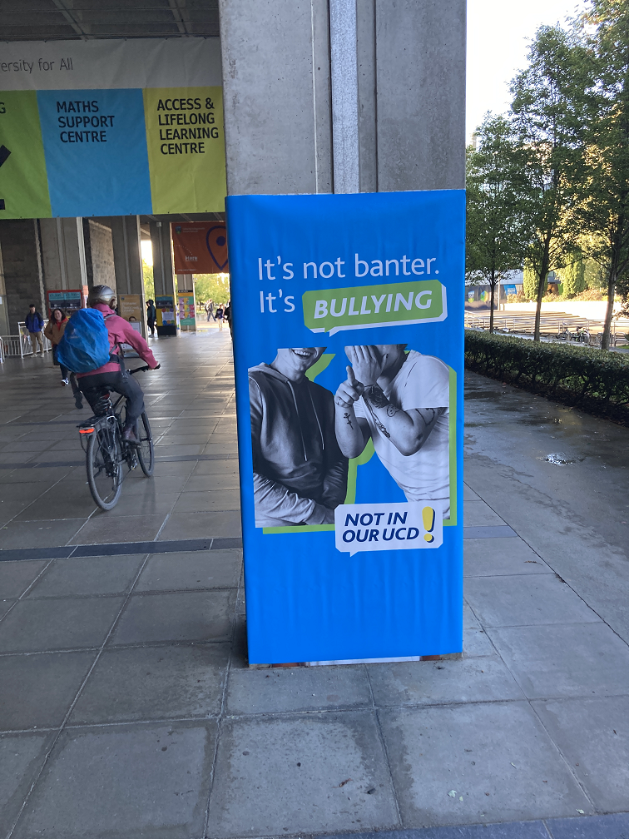
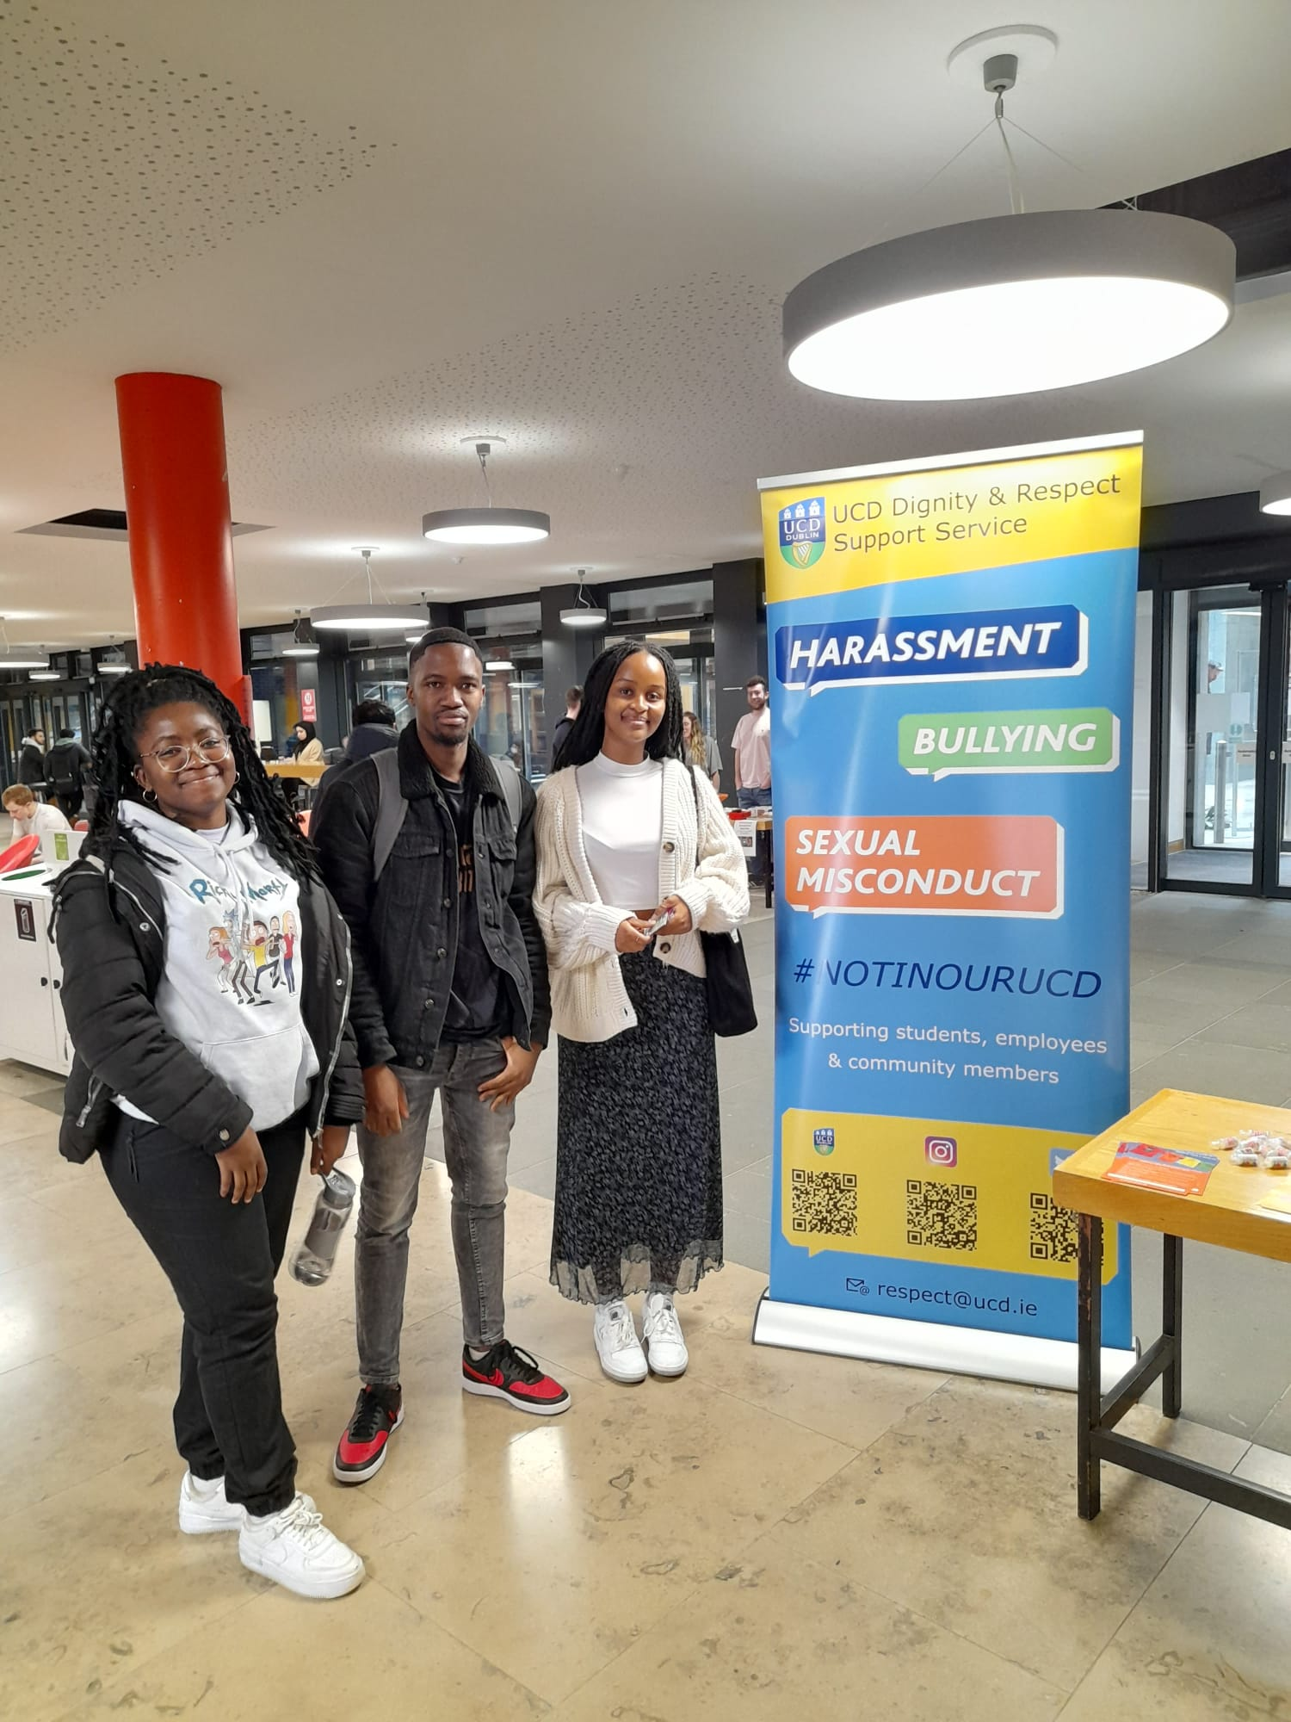
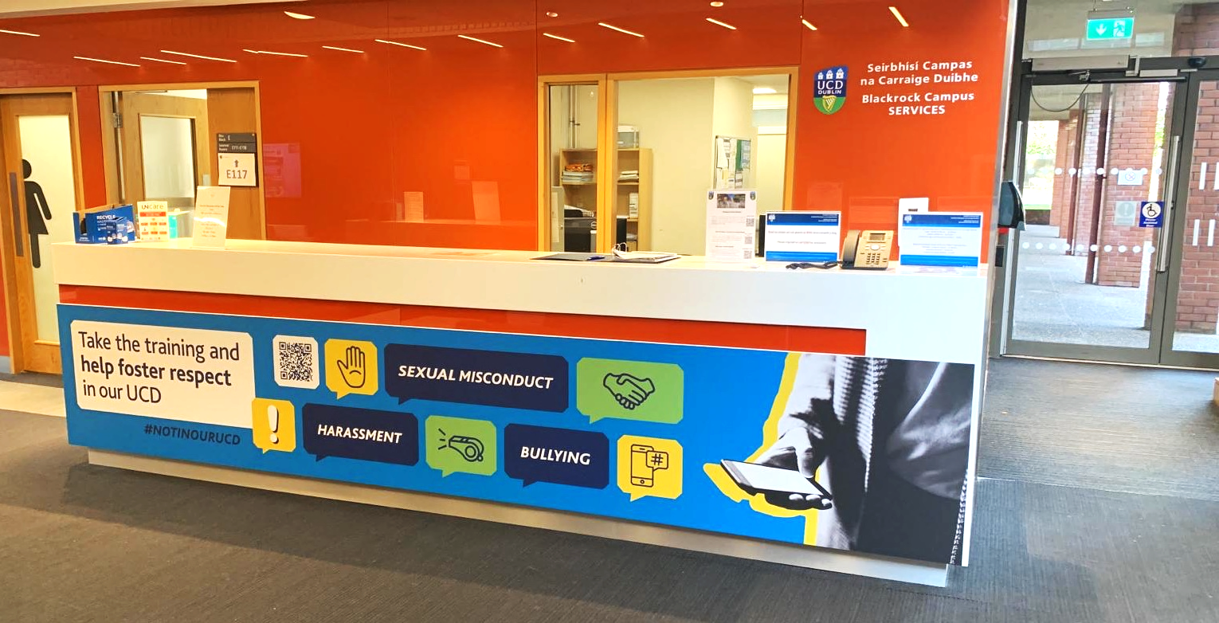

Slide 5
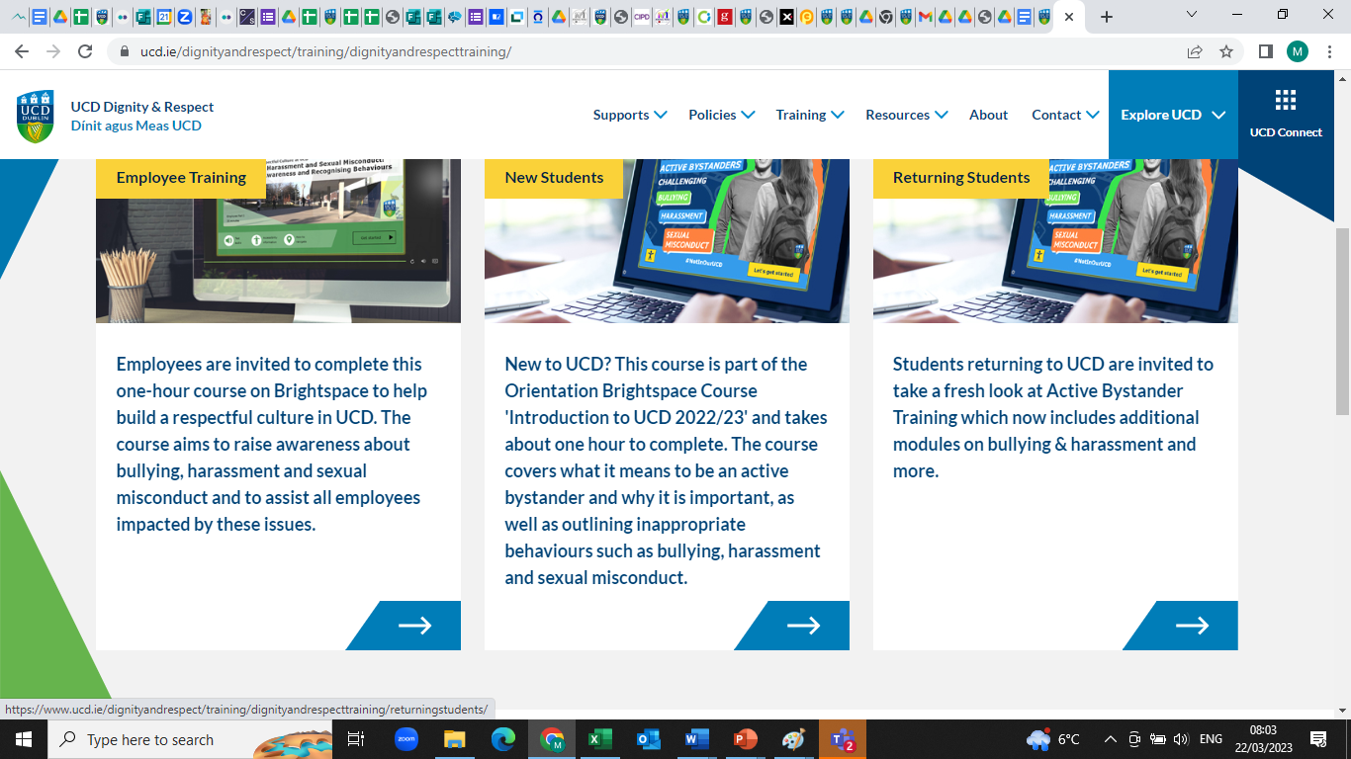
Three Tiers of Training
Specialist Supports
People Manager face-to face training
Online Training including Bystander – all employees and students

Slide 6
Learnings
Listening to the UCD Community
Shared Ownership across key stakeholder areas
Partnership with students
Engagement with external bodies
Constantly evolving policies and processes
Multipronged approach to achieve culture change
Resources
Key Message: Push the boundaries and be innovative!

Slide 7
THANK YOU.

