Slide 1



This is Your Presentation Title
Image: UCD Library Outreach Team
End Period Poverty Initiative
at UCD Library
Catherine Bodey & Vanessa Buckley
UCD Library
Catherine.bodey@ucd.ie
Vanessa.r.buckley@ucd.ie

Slide 2


Collaboration
UCD Dean of Students

Slide 3
Period Poverty
Period poverty is the lack of access to adequate menstrual hygiene including period products, washing and waste management facilities
53,000-85,000 women in Ireland are at risk of period poverty
50% of 12-19 years olds have experienced occasional period poverty
61% have missed school as a direct result of their period
Plan International Ireland https://www.plan.ie/campaigns2/we-need-to-talk-period/
Period Poverty Sub-Committee, National Strategy for Women and Girls 2017–2020. (2021). Period poverty in Ireland: Discussion paper. Available at: https://www.gov.ie/en/publication/264f4-period-poverty-in-ireland-discussion-paper-period-poverty-sub-committee-national-strategy-for-women-and-girls-20172020-february-2021/

Slide 4

EDI at the heart of all we do
To promote a culture of dignity, respect and well-being for all, and eliminate all forms of discrimination
UCD EDI Strategy and Action Plan Priorities for 2021 - 2024
UCD Strategy 2020-2024: Rising to the future

Slide 5
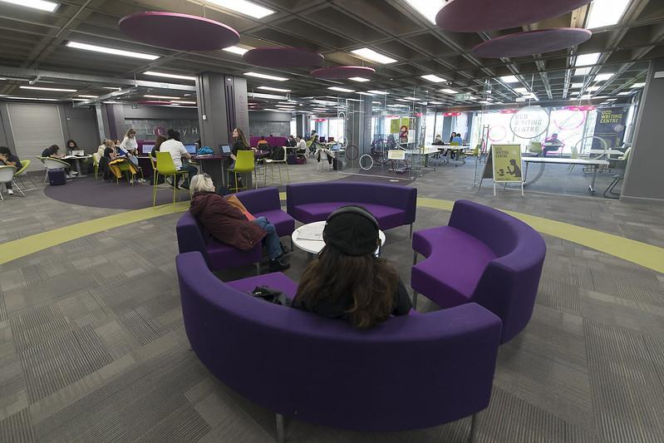
Image by Vincent Hoban, IT Services, University College Dublin
Creating an inclusive library for all

Slide 6
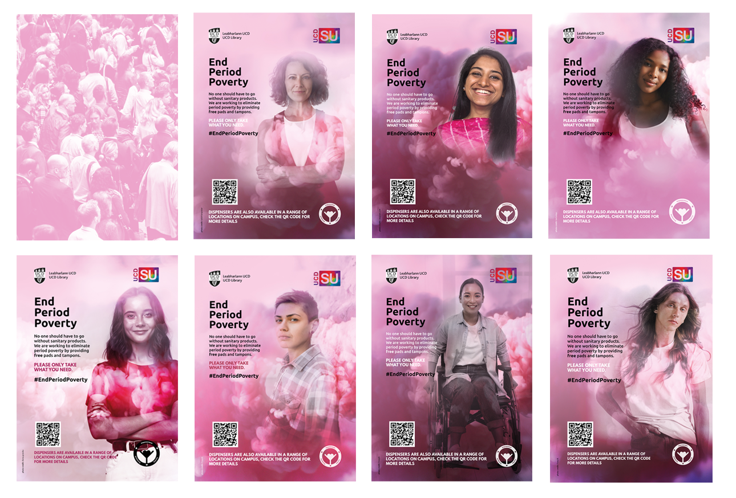
People Have Periods
Notes:
The concept was influenced by the term, ‘People Have Periods’. A term used by Callaly, a femcare start-up.
We wanted our campaign to speak to every member of the UCD community
However:
Production took a lot longer as we had to create artwork for a cast of 7
We missed a prime opportunity to launch before Munster Technological University as the enormity of the task was under-estimated
Being too prescriptive – there’s the danger that you might leave someone out (like a ‘thank you’ speech at the Oscars)

Slide 7
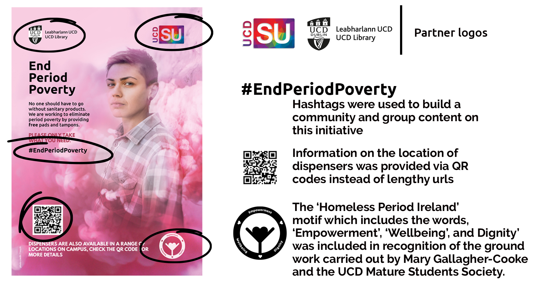
The anatomy of a poster
Notes:
The factors that made this campaign successful
Location of dispensers were provided via the QR code
Make your campaign as inclusive as possible by using imagery that speaks to everyone
Using gender neutral language to include everyone:
‘No one should have to go without sanitary products. We are working to eliminate period poverty by providing free pads and tampons. Please only take what you need’.

Slide 8
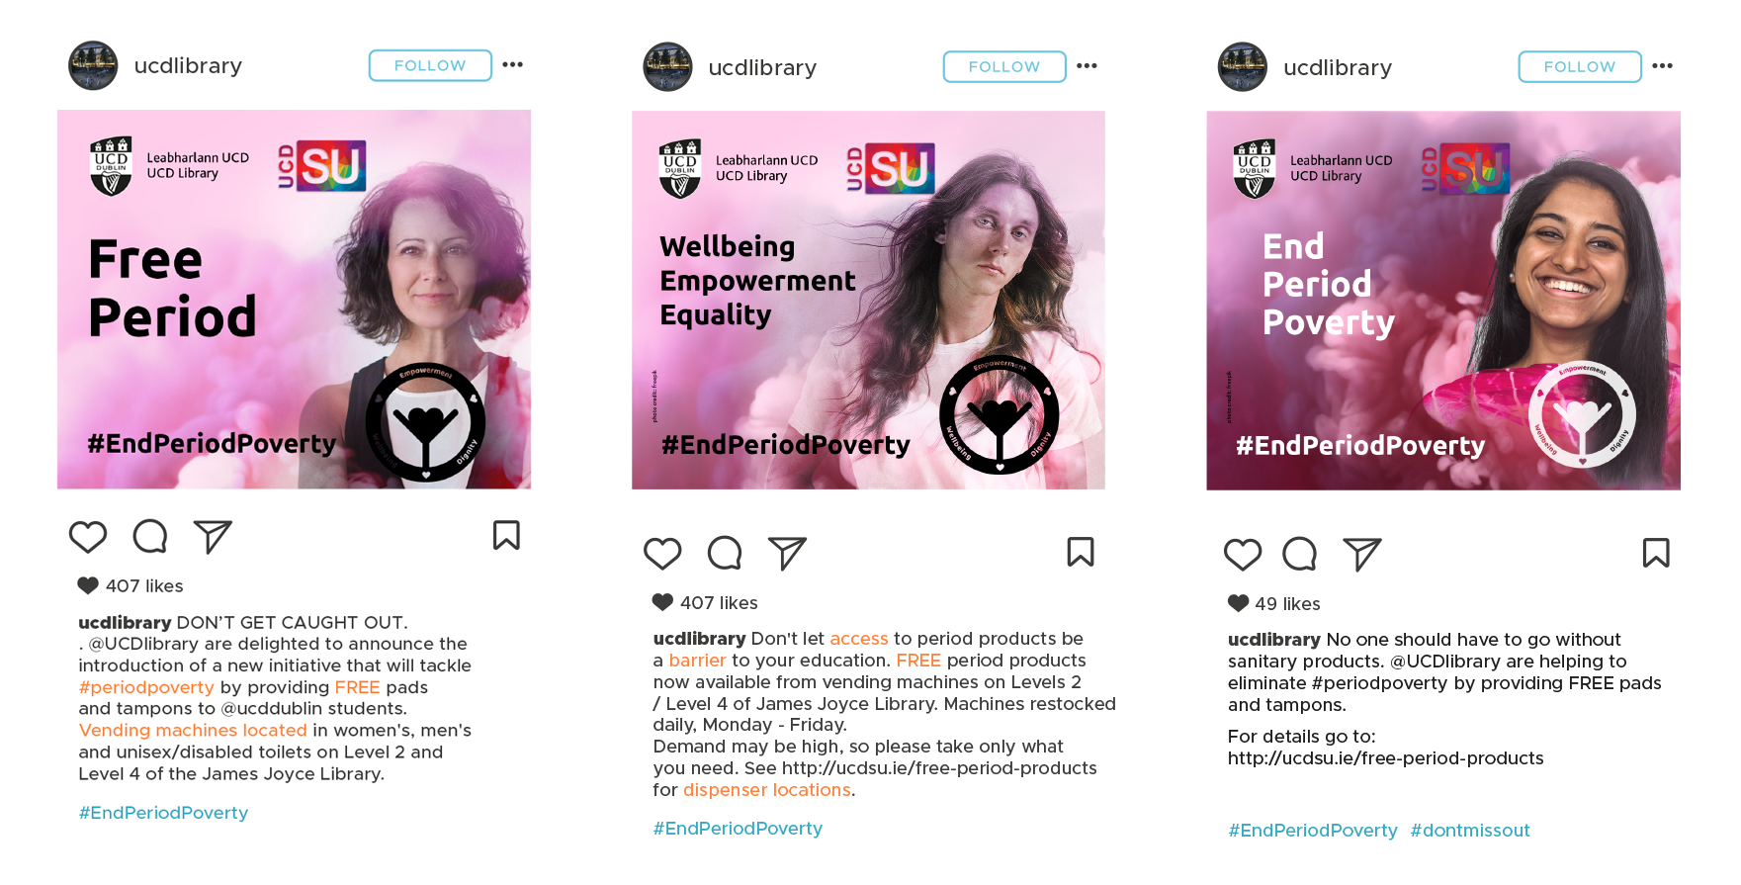
Watch your language
Notes:
The UCD Library campaign used language that was clear, direct, inclusive, and gender-neutral and highlighted the ‘free’ angle. It was an educational and good news piece;
When writing content for our social media channels we made sure that words like empowerment, confidence, well-being, dignity and respect were used;
Keep personality and messaging consistent.

Slide 9
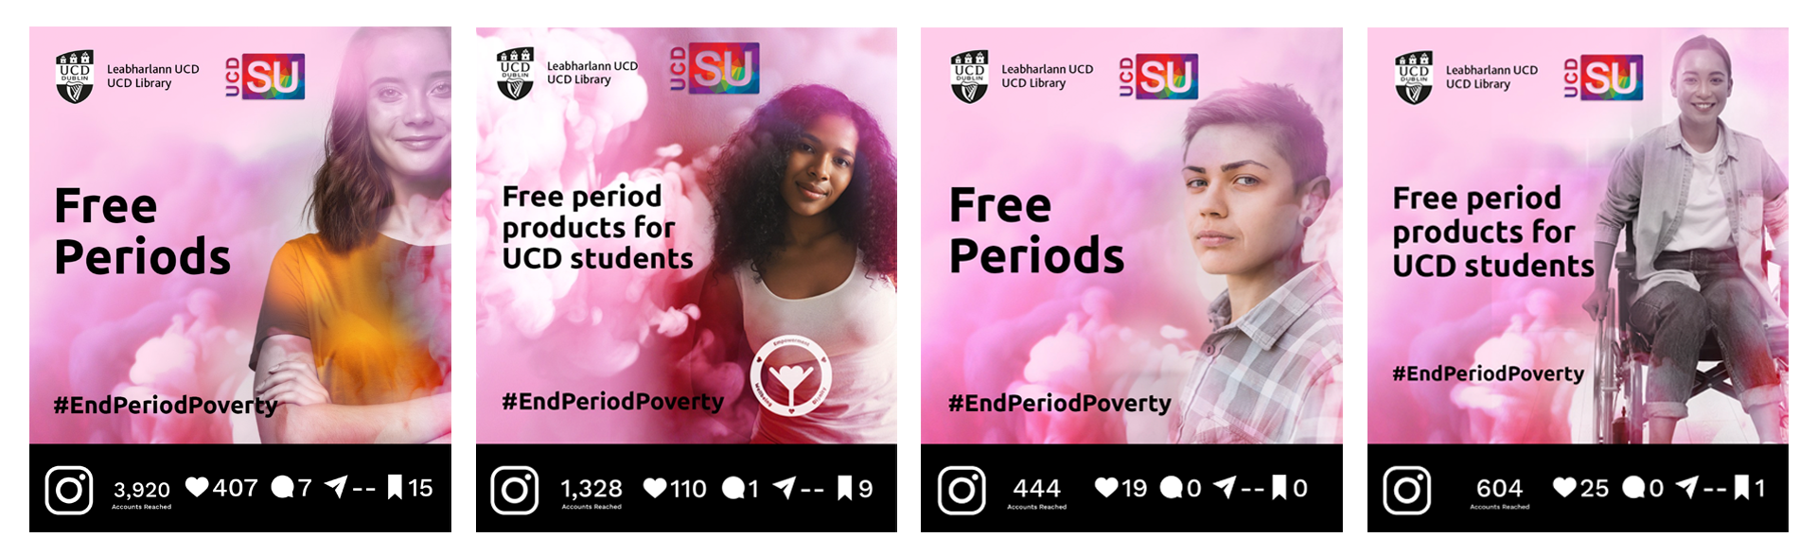
Harnessing social media to amplify your message
Notes:
Use the networks you’ve built to extend your message;
Curated a list of relevant accounts, tag them on our posts and ask them to share;
Our first post on Instagram resulted in the highest number of ‘likes’ ever recorded on the Library Instagram account;
The same post reached almost 4,000 unique accounts.

Slide 10
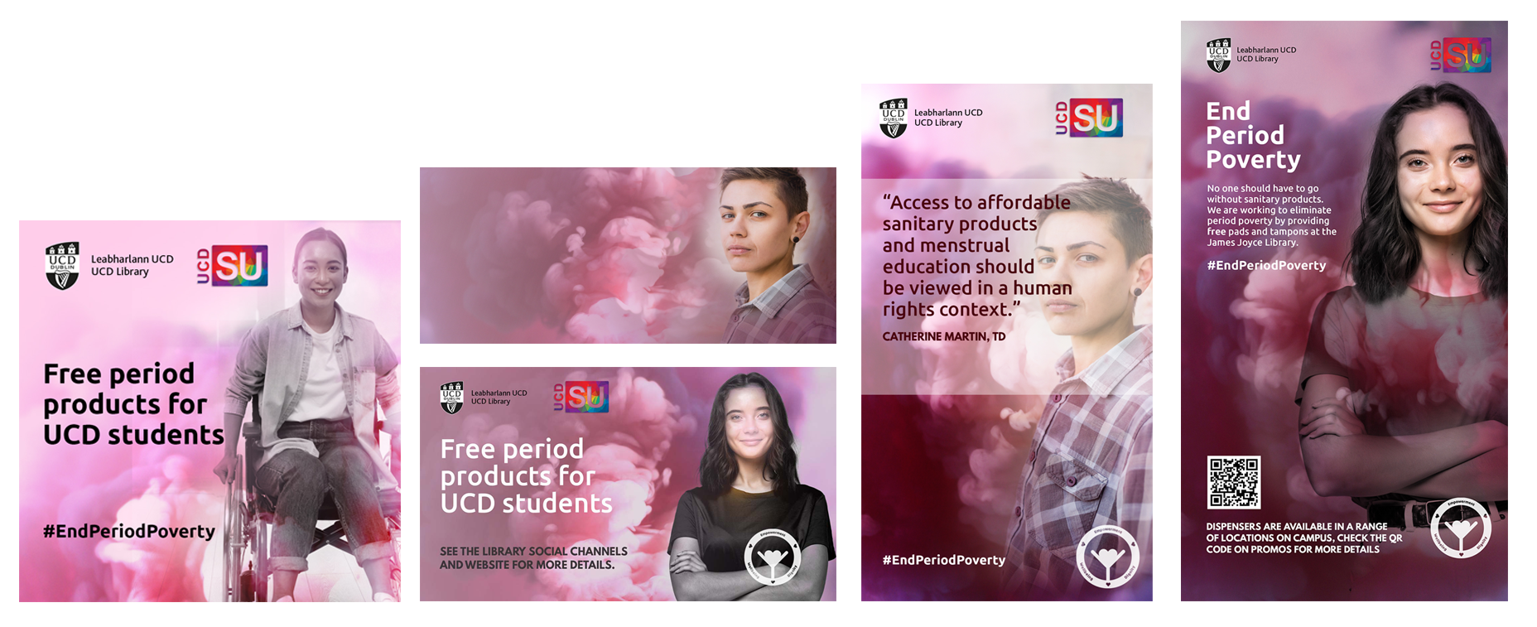
Use all the channels at your disposal
l-r, top to bottom: Instagram; UCD Library Homepage; Twitter and Facebook; Instagram Stories; and the plasma screen at the O’Brien Centre for Science.
Notes:
Make your brand visible on all relevant platforms;
Ask colleagues in other campus locations to display your content
Strengthen your brand by establishing and maintaining brand consistency.

Slide 11
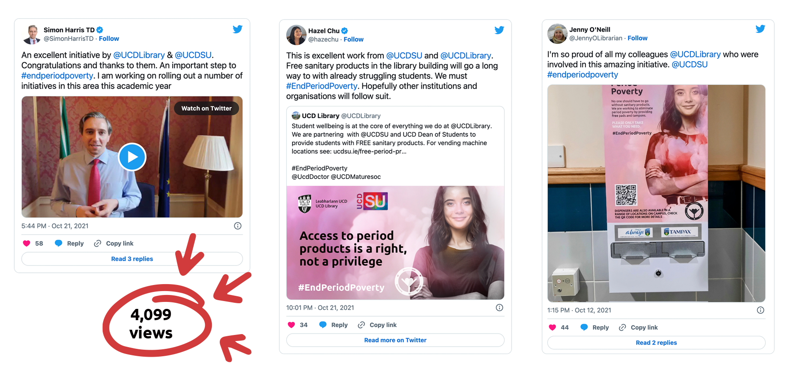
Hitting the jackpot
Notes:
Don’t be shy. Tag people powerful people. Just make sure you that what they do is relevant to what you’re trying to achieve.
Minister for Justice and Minister for Further and Higher Education, Research, Innovation and Science, Simon Harris, called it ‘an excellent initiative’ and went on to say he was working on rolling out a number of initiatives in this area this academic year.
Hazel Chu, former Lord Mayor of Dublin and Green Party Councillor praised the ‘excellent work’, and added that she hoped other institutions and organisations to follow suit

Slide 12

Operation and lessons learnt…
Operation
library volunteers & SU staff
refilled daily
Over 17,000 individual items supplied
Dispensers - simple is best
visual stock check
easy to refill
Product
environmental impact
Notes:
Lessons learnt - what we would do differently - what we changes or how adapted

Slide 13
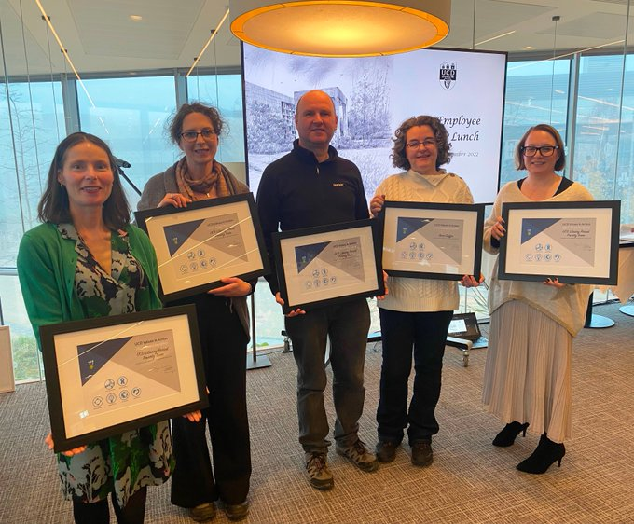
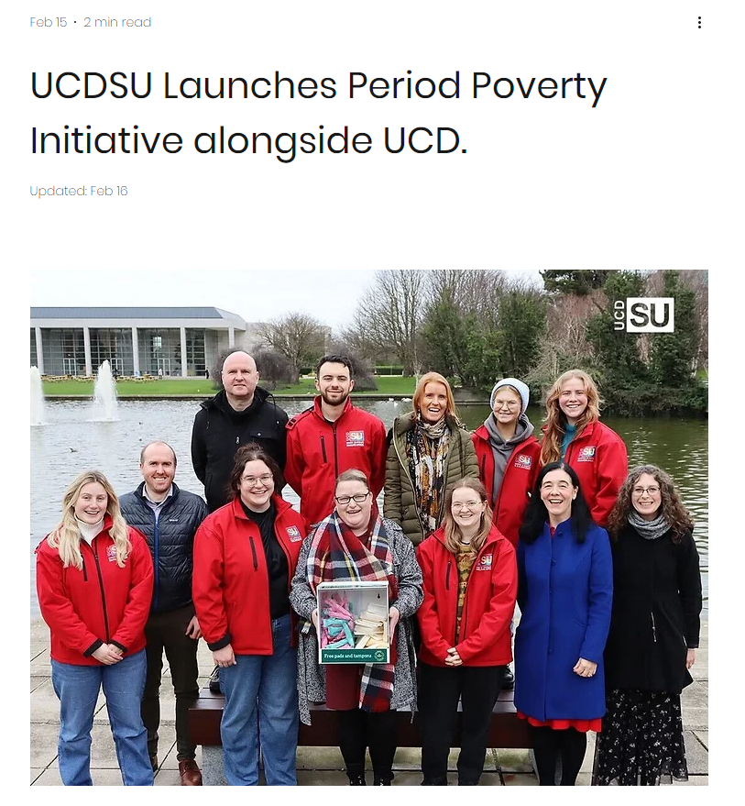
Impact
Awarded ‘UCD Values in Action Award 2022’
upholding the value UCD places on engagement, excellence, creativity and diversity
‘Proof of concept’ for university wide roll-out
Members of UCD Library receiving ‘UCD Values in Action Awards 2022’

Slide 14
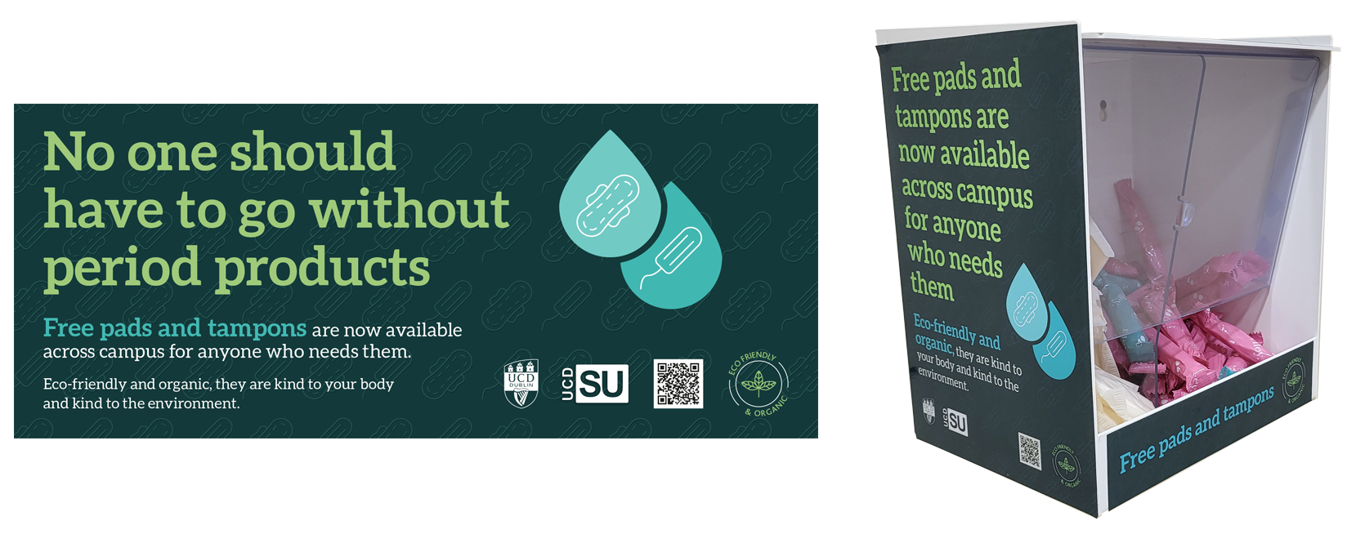
And how does it look now
Notes:
With the education piece out of the way, the University were able to focus on promoting the eco-credentials of the product;
The University design brief specified: no images of people, use of neutral colours, and neutral language, with dignity for all in mind;
The language continued in the same vein as the Library campaign: ‘No one’, ‘for anyone’, and ‘Free’.

Slide 15
Thank you to all UCD Library and UCDSU staff involved in the initiative

